Slide 1







Electronics Component Inventory and Procurement Analysis Dashboard
A Data-Driven Approach to Inventory Visibility and Procurement Analysis
Presented By
Shashaank Vijayakumar Sajjanar
Register Number: [INSERT REGISTER NUMBER]
SYSTEM INTEGRATION & ANALYTICS ARCHITECTURE

Slide 2



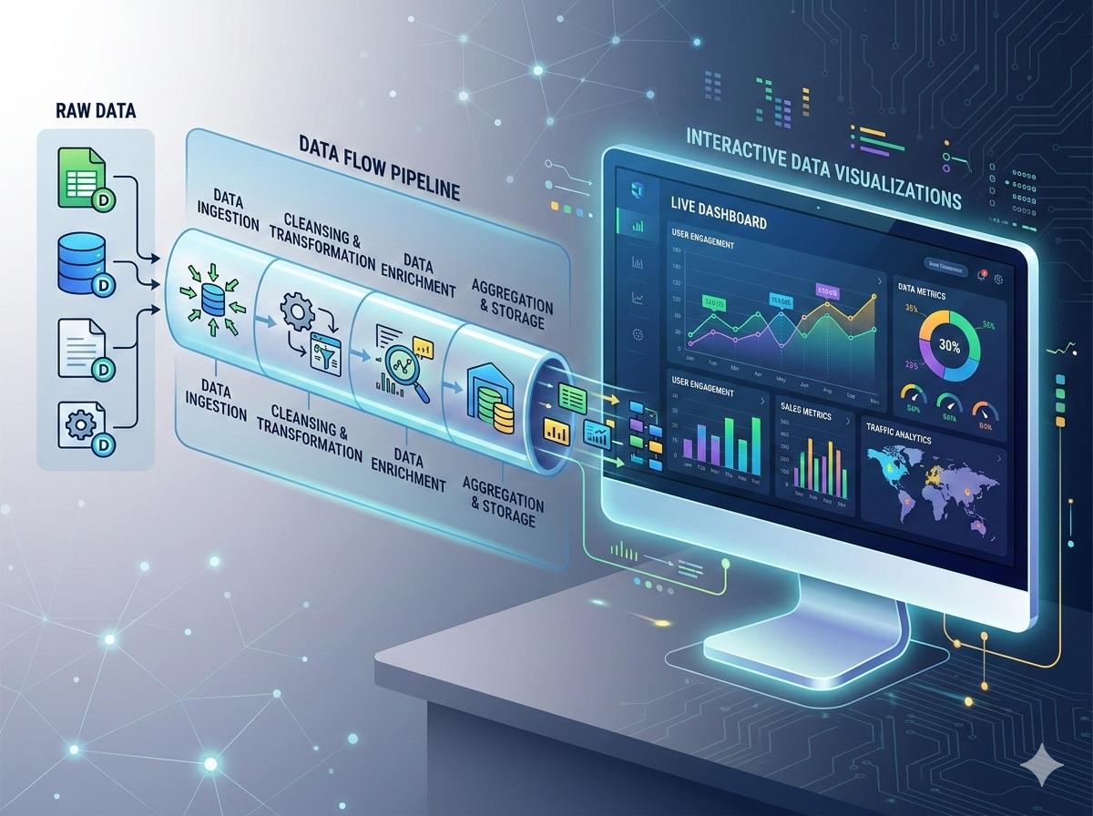
Interactive Inventory & Procurement Analytics
Power BI Analytics Dashboard for Electronics Laboratories & Manufacturing
Executive Summary
Electronic components are essential resources in lab and manufacturing environments. Efficient inventory operations require strict management of availability, stock quantities, categories, condition, and procurement costs.
Data Transformation Architecture
Raw Data
Excel • MySQL
Preparation
Power Query ETL
Analysis
Python & Models
Power BI Dashboard
Interactive Insights
Integrated Data Pipeline
Raw inventory metrics pass through automated cleaning, validation, and relational modeling before rendering live KPI cards, stock status distributions, and procurement analytics.
Workflow Stack: Excel • Power Query • MySQL • Python • Power BI
Key Focus Areas
Inventory Visibility
Real-time stock quantities & location tracking
Inventory Analysis
Categorization, condition & aging metrics
Procurement Analysis
Cost optimization & supplier performance
PRIMARY TECHNOLOGY STACK & TOOLS
Decision Support
Interactive insights for lab operations
X
Excel
Power Query
MySQL
Py
Python
Power BI
PQ
SQL
BI

Slide 3



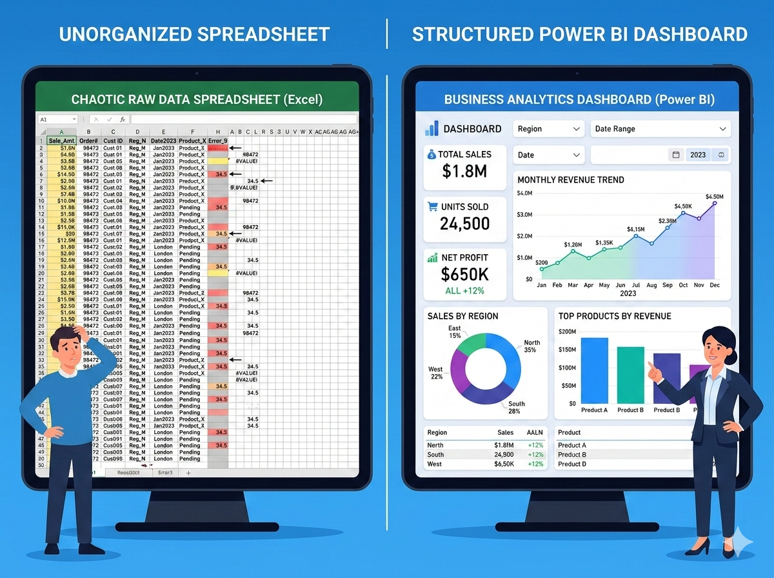
Managing Electronic Component Inventory
Addressing critical data challenges with a centralized analytical solution
Key Challenges (Spreadsheet Records)
Limited visibility into real-time stock levels & availability
Inconsistent inventory records across component categories
Difficulty comparing procurement costs & purchasing activity
Proposed Solution (Analytical Dashboard)
Consolidated analytical view of inventory & procurement
Automated KPIs tracking stock levels & purchasing patterns
Actionable insights to eliminate shortages & optimize spend
Data Transformation: Raw Spreadsheets to Active KPIs

Slide 4
Core Project Objectives
01
02
03
Data Ingestion
Data Transformation
Structured Storage
Collect and standardize electronic component inventory data across systems.
Utilize Power Query to handle data inconsistencies, errors, and missing values.
Organize and store clean, structured datasets efficiently using MySQL database.
04
05
06
Inventory Analysis
Procurement Analysis
Interactive Dashboard
Conduct comprehensive stock analysis covering stock availability and total valuation.
Evaluate purchasing costs, supplier metrics, and overall vendor performance.
Develop an interactive Power BI dashboard with KPIs, slicers, and drill-throughs.

Slide 5

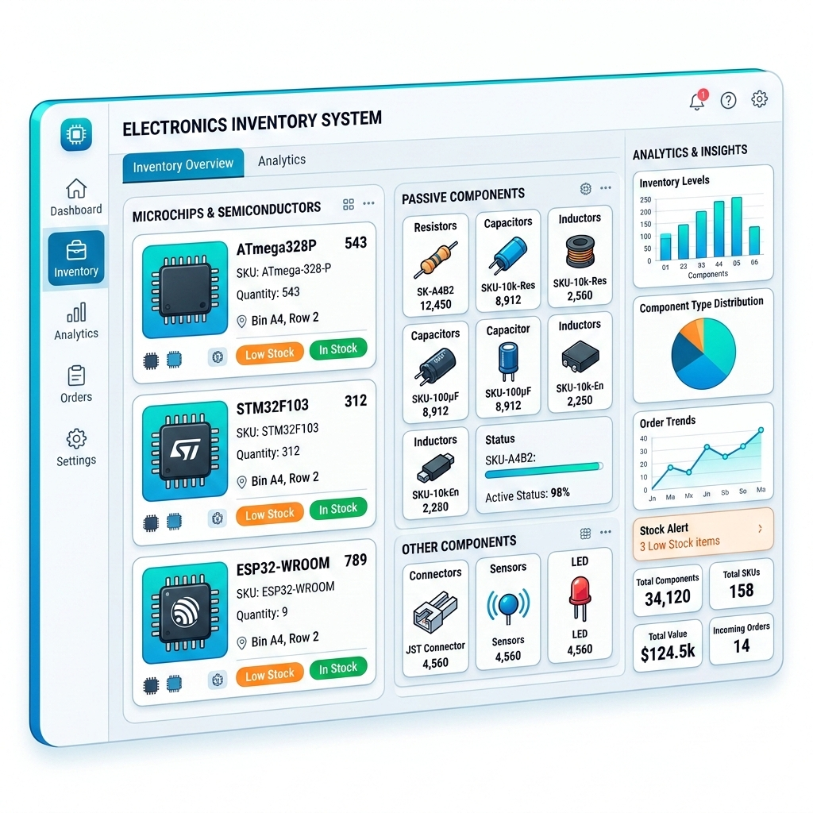
Project Scope & Boundaries
INCLUDED SCOPE (Descriptive & Diagnostic)
EXCLUDED FROM SCOPE
Component Inventory Analysis: Tracking stock state and part availability.
Full ERP Application Development
Category-Wise Distribution: Breakdown across microchips, passives, and hardware.
Live Inventory Transaction Management
Low-Stock Identification: Automated alerts for critical threshold replenishment.
Inventory Valuation & Condition: Asset value metrics and quality health assessment.
Real-Time Warehouse Integration
Rental Availability: Monitoring equipment status and active checkouts.
Production Planning Modules
Procurement Expenditure Analysis: Diagnostic insight into sourcing spend.
Advanced Predictive Forecasting (Due to insufficient historical data)

Slide 6
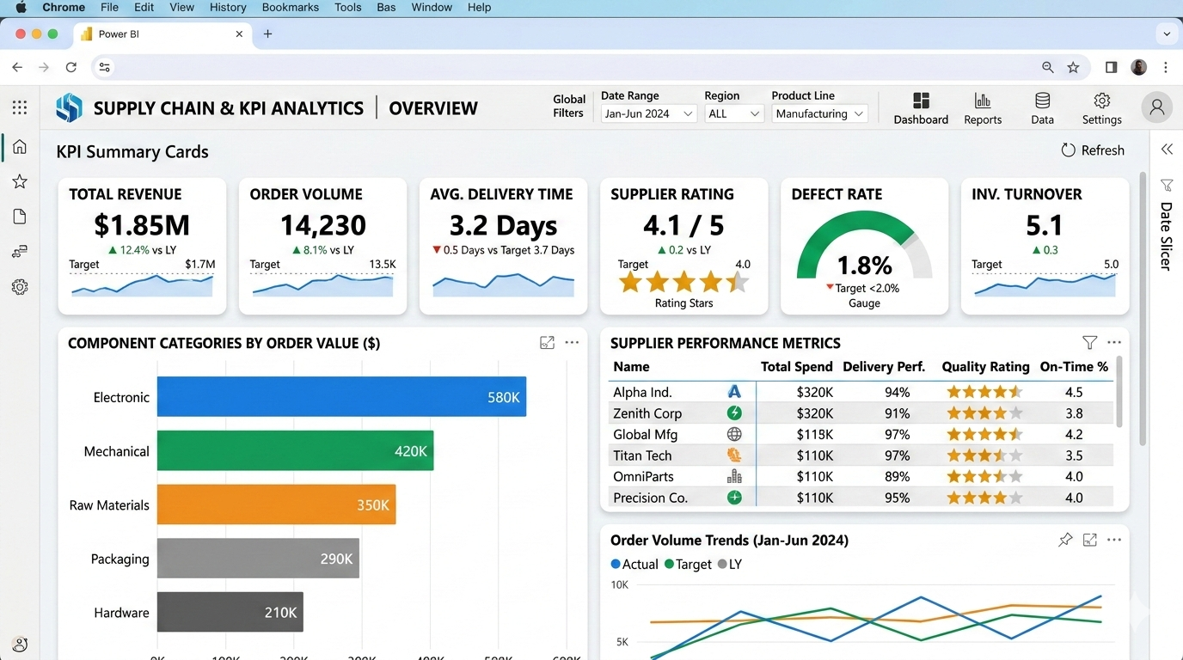
Dashboard Business Requirements
Key Functional Capabilities & Mockup Architecture
Target Analytics Interface Mockup
1. Inventory Visibility
Total component counts & real-time tracking via Bar and Donut distribution charts.
2. Stock Monitoring
Low-stock alerts & threshold monitoring using Radial Gauges & Bullet bars.
3. Inventory Valuation
Category valuation & unit costs using Stacked Column and Treemap charts.
4. Procurement Tracking
Purchase orders & supplier comparisons with Multi-line trends & Vendor tables.
5. Core Analytics UI
Executive KPI summary cards, interactive filter slicers & category drill-downs.
6. Interactivity & Rules
Cross-filtering, drill-through details & automated threshold indicators.
Unified Data Architecture
Integrates Bar/Donut distribution charts, Radial Gauges, Stacked trends, and KPI cards into a standardized Power BI dashboard view.

Slide 7
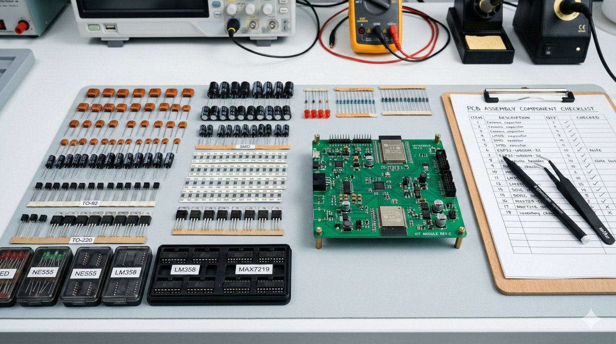
Dataset Overview & Key Fields
Inventory Fields Schema
Field Name
Description
Component ID
Unique identifier code
Component Name
Part title & specs
Category
Passive, Active, Discrete
Stock Quantity
Current units available
Cost Per Unit
Unit valuation price
Data Preparation & Sourcing Protocol
Condition
Operational status
Structure Inspection: Audit Excel workbook layout, addressing missing fields or duplicate entries.
Standardization: Standardize component categories and validate numerical stock quantities.
External Procurement: Integrate secondary sources; all simulated data is explicitly tagged.
Rental Avail.
Checkout permission flag

Slide 8
Thank You
Questions & Discussion
Electronics Component Inventory and Procurement Analysis Dashboard
A Data-Driven Approach to Inventory Visibility and Procurement Analysis
Presented By
Shashaank Vijayakumar Sajjanar
Register Number: [INSERT REGISTER NUMBER]
Tools & Technologies: Excel • Power Query • MySQL • Python • Power BI

